Slide 1

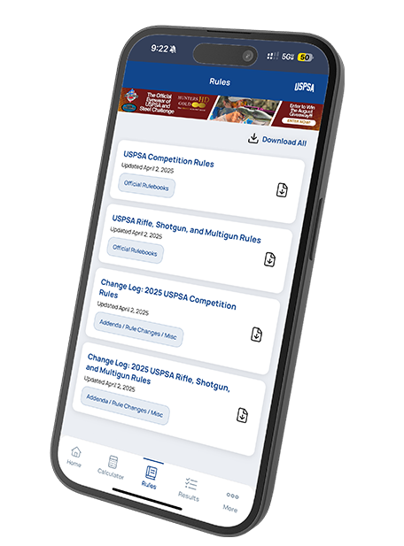
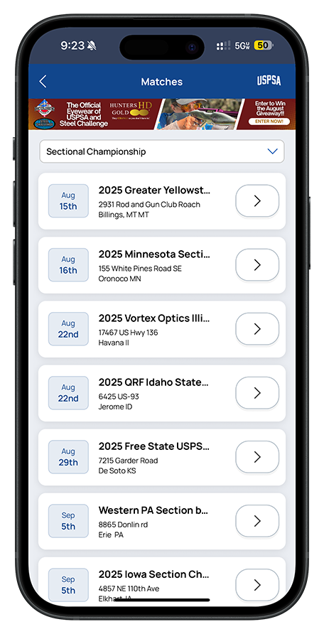
USPSA Mobile App
Business Need
USPSA needed a single mobile application that brought essential competitor tools into one easy to use experience. Members required mobile access to classifications, match results, club information, rules, and calculators to support participation on and off the range. The organization also needed a modern cross platform solution that could scale as new features were added.
What We Did
Designed and developed a cross platform mobile app using React Native for iOS and Android
Built core competitor features including classification lookup, match results, rules reference, club search, and calculators
Integrated with official USPSA and Steel Challenge data sources for accurate, up to date information
Implemented secure member authentication and personalized profiles
Architected the app to support future feature expansion
Results
Delivered a high performing mobile app that consolidates USPSA tools into a single experience
Enabled fast, convenient access to key competitor information from any device
Improved the overall member experience with a responsive, intuitive interface
Provided a scalable foundation for continued digital growth

